Slide 1
Summary Revenue/Expenses FY 2017 – FY 2025 Plus To Date FY 2026 Transfers In From General Fund
Time Period | Revenue Receipts | Expenditures | True Profit / Loss for Detention Center |  | Cash as of First Day of Period | Supplemental from General | Debt / Refinancing
July 1, 2016 - June 30, 2017 | $2,338,729.12 | $2,877,569.12 | -$538,840.00 |  | $11,922.99 | $497,500.00 | $54,313.98
July 1, 2017 - June 30, 2018 | $2,516,479.75 | $2,770,600.12 | -$254,120.37 |  | $25,922.87 | $317,000.00
July 1, 2018 - June 30, 2019 | $2,951,311.12 | $2,948,103.52 | $3,207.60 |  | $89,209.80 | $0.00
July 1, 2019 - June 30, 2020 | $3,120,086.87 | $3,201,200.50 | -$81,113.63 |  | $92,417.40 | $0.00
July 1, 2020 - June 30, 2021 | $3,445,585.13 | $3,203,735.92 | $241,849.21 |  | $11,303.77 | $ 0.00
July 1, 2021 - June 30, 2022 | $3,468,733.12 | $3,468,387.85 | $345.27 |  | $253,152.98 | $0.00 | $5,899,678.13
July 1, 2022 - June 30, 2023 | $3,499,567.03 | $3,472,315.69 | $27,251.34 |  | $253,498.25 | $0.00
 |  |  |  |  |  | $0.00
07/01/2022 - 12/31/2022 | $1,849,620.01 | $1,737,756.19 | $111,863.82 |  | $253,498.25 | $0.00
01/01/2023 - 06/30/2023 | $1,649,947.02 | $1,734,559.50 | -$84,612.48 |  | $365,362.07 | $0.00
July 1, 2023 - June 30, 2024 | $3,668,941.82 | $3,783,076.88 | -$114,135.06 |  | $280,749.59 | Amt was actual Reim for Hail Dam so included in Revenue Receipts
July 1, 2024 - June 30, 2025 | $3,383,081.27 | $3,791,354.93 | -$408,273.66 |  | $166,614.53 | $309,700.00
July 1, 2025 - August 22, 2025 | $484,783.08 | $574,286.08 | -$89,503.00 |  | $68,040.87 | $25,000.00
 |  |  |  |  | August | $39,000.00
 |  |  |  |  | September | $85,000.00
 |  |  |  |  | Total @ 9-15-2025 | $149,000.00
 |  |  |  |  | Avg./Mo. 2025 | $49,666.67
 |  |  |  |  | Bud. Avg./Mo. 2025 | $19,764.67
 |  |  |  |  | Over Bud. Xfers/mo. | $29,902.00

Slide 2
Jailer Submitted FY 2026 Budgeted Revenue (Rcvd. March 20, 2025) Jailer Submitted FY 2026 Budgeted Expenses (Rcvd. March 20, 2025)

Slide 3
From: Athena Hayes <athena.hayes@crittendencountyky.org>
Sent: Thursday, March 20, 2025 7:14 AM
To: Yvette Martin <yvette.martin@crittendencountyky.org>
Subject: Jail Budget worksheet 2025-2026
I have attached the proposed budget for 2025-2026 fiscal year.
Athena Hayes
Crittenden County Jailer
Crittenden County Detention Center
208 W. Carlisle Street
Marion, KY
42064​
270-965-3185 (Main Jail)
270-775-0848 (Desk)

Slide 4
FY 2025 Actual
Receipts/Expenses

Slide 5
This Boils Down to Housing and Revenue Shortfalls:
FY 2025 Summary
FY 2025 Revenues:
Federal Housing: Actual $1,332,489.00 @ $57.00/day = Avg. Inmate/Day of 63.45 Budgeted $1,497,960.00 @$57.00/day = Avg. Inmate/Day of 72
State Housing: Actual $ 847,075.18 @ $33.19/day = Avg. Inmate/Day of 70.09 Budgeted $1,341,500.00 @$33.19/day = Avg. Inmate/Day of 110
Housing Shortfalls:
Federal Inmates Revenue Short of Budget: $165,471.00.
State Inmates Revenue Short of Budget: $494,424.82.
Total Revenue under Budgeted Receipts for housing FY 2025: $659,895.82
** If housing revenue budgets were met there would not have been a need to transfer $309,700.00 from the General Fund to the Jail last year.

Slide 6
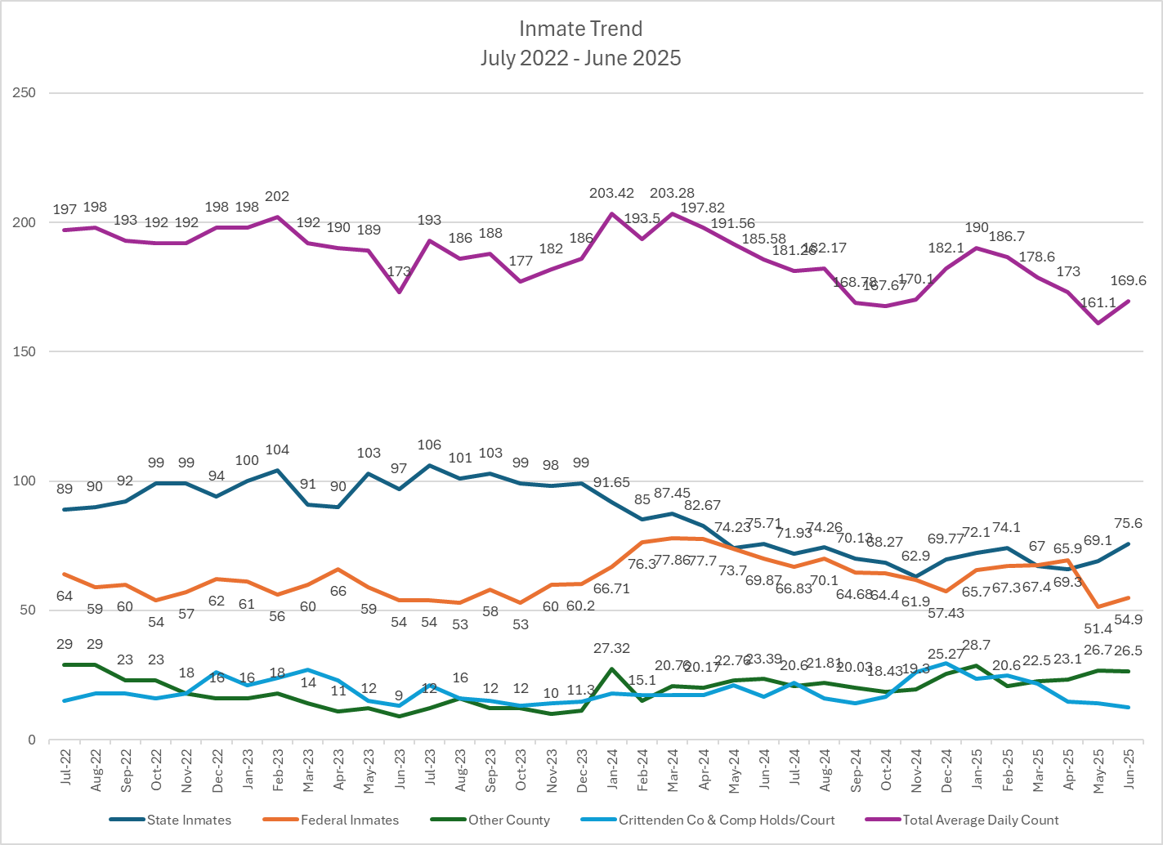

Slide 7
Housing Budget vs. Actual for FY 2026
FY 2026 Housing Revenues Budgeted:
Federal Housing: $1,450,000.00 @$57.00/day = Avg. Inmate/Day of 70
State Housing: $1,031,928.00 @$33.19/day = Avg. Inmate/Day of 85
FY 2026 Housing Revenues Actual:
Federal Housing (July and August): $180,918.00 @ $57.00/day = Avg. Inmate/Day of 52 Short of Budget by 18/day or $62,586.00
State Housing (July and August): $154,333.50@$33.19/day = Avg. Inmate/Day of 76 Short of Budget by 9/day or $18,221.31
Total Housing Revenue Short: $80,807.31.

Slide 8
FY 2026 Budgeted Transfers to the Detention Center
Vs. Actual Transfers to Date
FY 2026 Budgeted Transfers:
To achieve a balanced budget for the detention center this fiscal year required a budgeted FY 2026 transfer of General Fund dollars into the Jail budget of $237,176.00.
This is an average transfer per month of $19,764.67.
FY 2026 Actual Transfers to Date:
July 2025 resulted in a transfer from the General Fund to the Jail Fund of $25,000.00.
August 2025 resulted in a transfer from the General Fund to the Jail Fund of $39,000.00.
To date, September has resulted in transfers from the General Fund to the Jail Fund of $85,000.00.
Total Amount Transferred from the General Fund to the Jail Fund to date:
$149,000.00 or an average of $49.666.67 which is $29,902.00 more than budgeted.

Slide 9
CORRECTIVE ACTIONS REQUIRRED:
ONE OR A COMBINATION OF THE FOLLOWING?
Budget amendments to reflect more realistic expectations on revenue.
Budget amendments to reflect an approximate cut in expenses of $470,000.00 for the remainder of FY 2026.
Professed limiting factors on revenue: Possible resolutions?:
State inmate availability 1) Bring in more federal inmates

Slide 10
CORRECTIVE ACTIONS REQUIRRED:
ONE OR A COMBINATION OF THE FOLLOWING?
Budget amendments to reflect more realistic expectations on revenue.
Budget amendments to reflect an approximate cut in expenses of $470,000.00 for the remainder of FY 2026.
Professed limiting factors on revenue: Possible resolutions?:
State inmate availability 1) Bring in more federal inmates
Cell availability due to required maintenance 2) Cell maintenance completed?

Slide 11
CORRECTIVE ACTIONS REQUIRRED:
ONE OR A COMBINATION OF THE FOLLOWING?
Budget amendments to reflect more realistic expectations on revenue.
Budget amendments to reflect an approximate cut in expenses of $470,000.00 for the remainder of FY 2026.
Professed limiting factors on revenue: Possible resolutions?:
State inmate availability 1) Bring in more federal inmates
Cell availability due to required maintenance 2) Cell maintenance completed?
Cut MO feds to provide open cell. 3) Cell maintenance completed?

Slide 12
CORRECTIVE ACTIONS REQUIRRED:
ONE OR A COMBINATION OF THE FOLLOWING?
Budget amendments to reflect more realistic expectations on revenue.
Budget amendments to reflect an approximate cut in expenses of $470,000.00 for the remainder of FY 2026.
Professed limiting factors on revenue: Possible resolutions?:
State inmate availability 1) Bring in more federal inmates
Cell availability due to required maintenance 2) Cell maintenance completed?
Cut MO feds to provide open cell. 3) Cell maintenance completed?
U.S. Marshalls-MO negative impact to budget so they cut us out

Slide 13
CORRECTIVE ACTIONS REQUIRRED:
ONE OR A COMBINATION OF THE FOLLOWING?
Budget amendments to reflect more realistic expectations on revenue.
Budget amendments to reflect an approximate cut in expenses of $470,000.00 for the remainder of FY 2026.
Professed limiting factors on revenue: Possible resolutions?:
State inmate availability 1) Bring in more federal inmates
Cell availability due to required maintenance 2) Cell maintenance completed?
Cut MO feds to provide open cell. 3) Cell maintenance completed?
U.S. Marshalls-MO negative impact to budget so they cut us out 4) Dep. U.S. Marshall Hergenroeder?

Slide 14
CORRECTIVE ACTIONS REQUIRRED:
ONE OR A COMBINATION OF THE FOLLOWING?
Budget amendments to reflect more realistic expectations on revenue.
Budget amendments to reflect an approximate cut in expenses of $470,000.00 for the remainder of FY 2026.
Professed limiting factors on revenue: Possible resolutions?:
State inmate availability 1) Bring in more federal inmates
Cell availability due to required maintenance 2) Cell maintenance completed?
Cut MO feds to provide open cell. 3) Cell maintenance completed?
U.S. Marshalls-MO negative impact to budget so they cut us out 4) Dep. U.S. Marshall Hergenroeder?
??? 5) ???

Slide 15
PROPOSED FY2026 Revenue Amendment

Slide 16
OUR FINAL QUESTION
Jailer Hayes,
How do you propose to address this issue of which cannot continue?

